Slide 1
Exploring Construction Careers
For EYFS and Key Stage 1
The East Sussex Primary Careers Hub

Slide 2
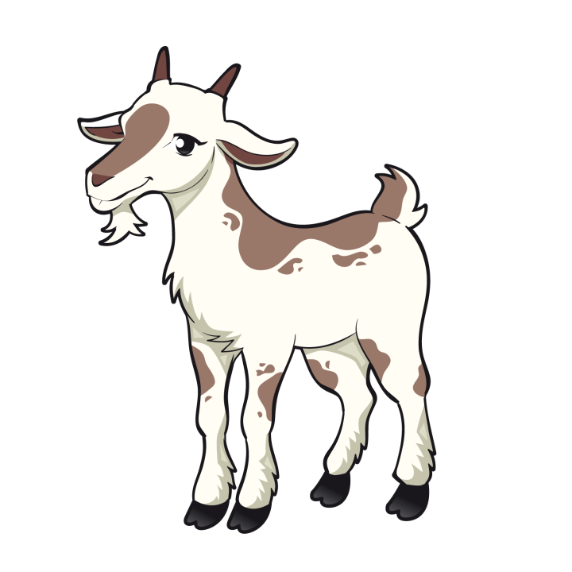
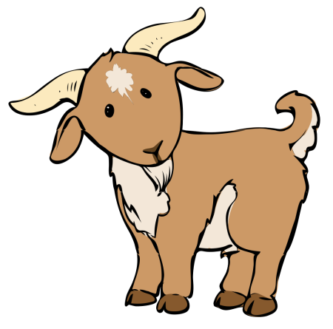
Helping the Billy Goats Gruff
Exploring careers in Construction and Engineering with EYFS/ KS1

Slide 3
This activity is designed to support a visit from 4 construction careers (individual’s jobs revealed at the end)
Quantity Surveyor
Building Operative
Civil Engineer
Health & Safety Adviser

Slide 4
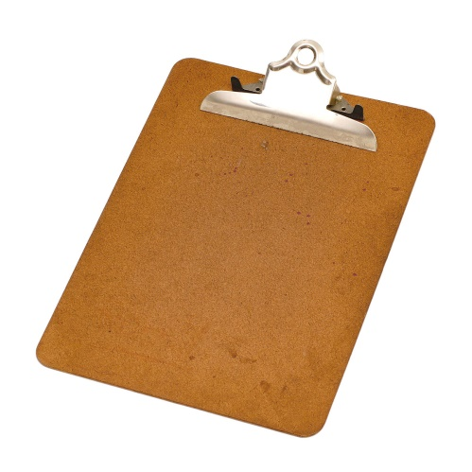
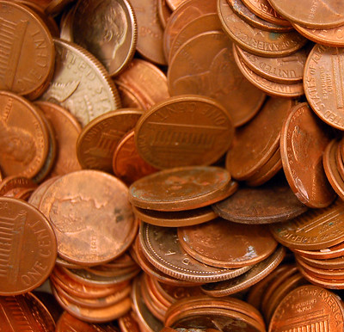
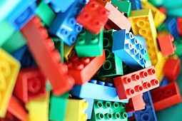
The main activity will be done in groups of 4. Each group will need:
A clipboard, pen and paper
Money
A tray (with some water added)
You will also need plenty of play bricks

Slide 5
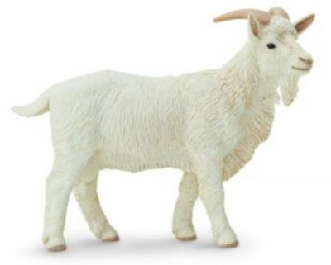
You will need something for weight testing like billy goat toys or an alternative such as a tin can.

Slide 6
Once upon a time, there were three little billy goats who lived in a field by a river.

Slide 7
The Billy Goats loved to eat juicy green grass all day long.

Slide 8
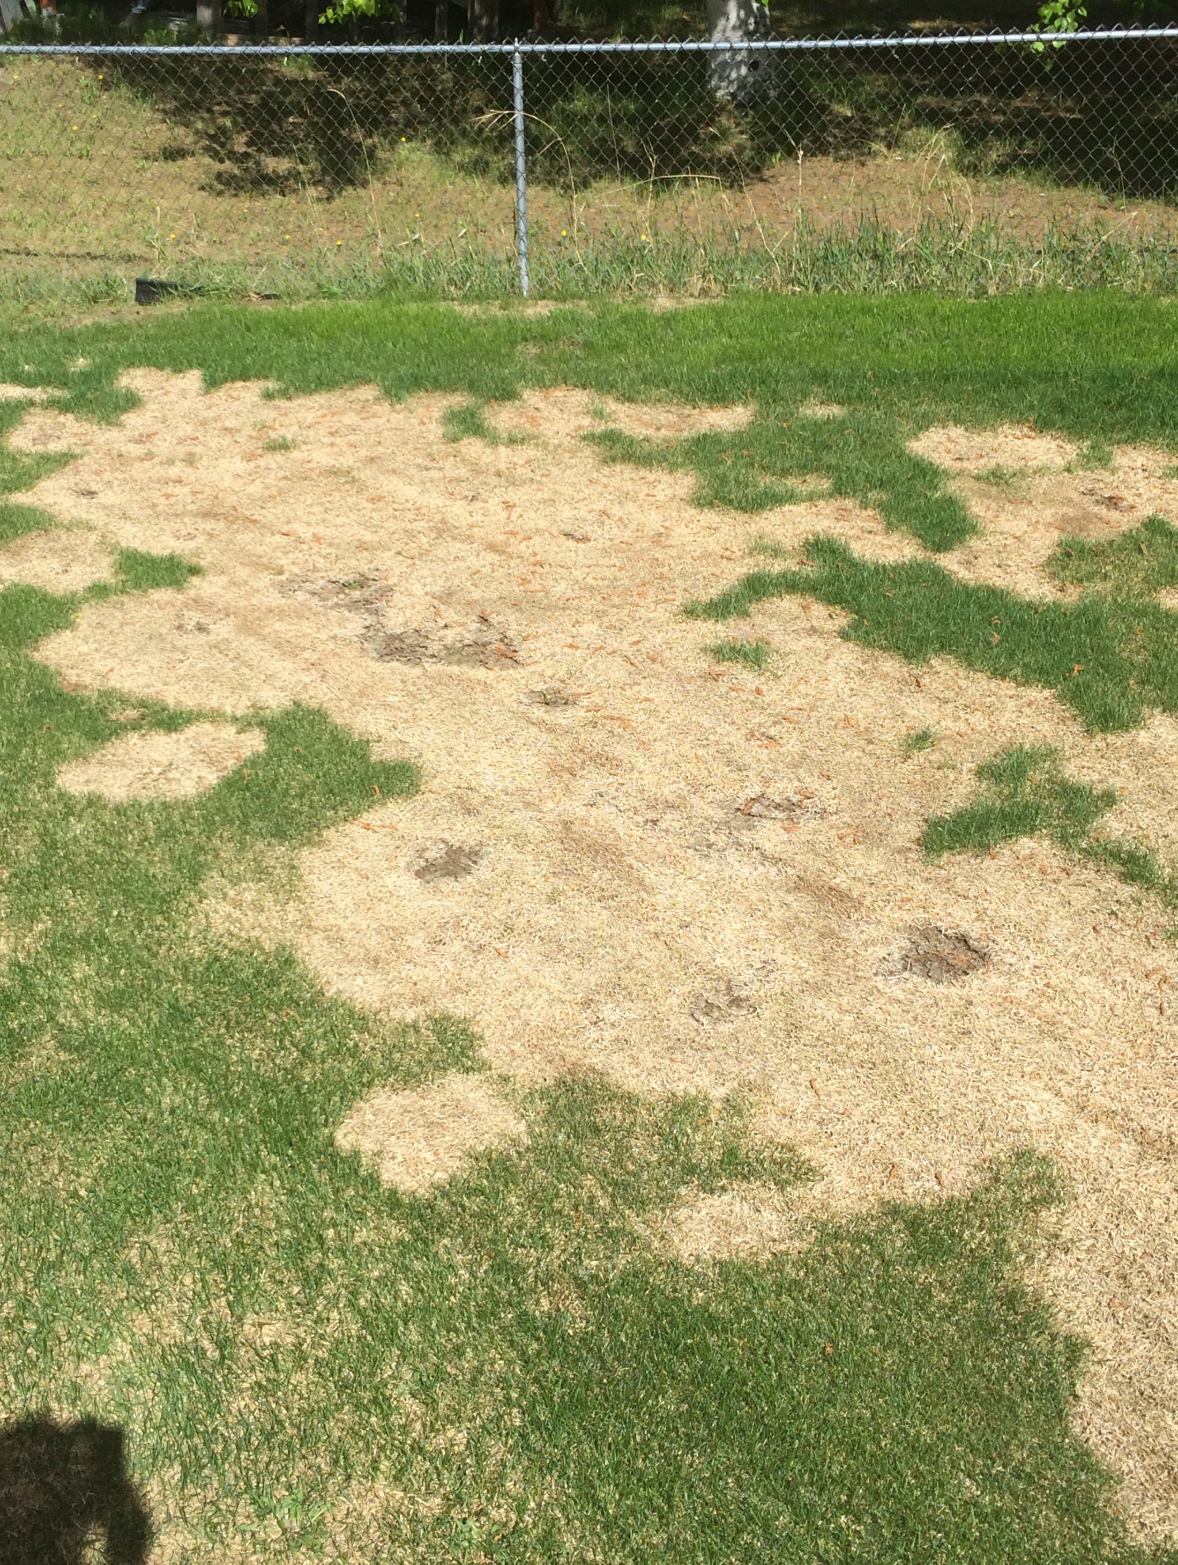
They
munched so much grass that their field started to look bare.

Slide 9
They wanted to cross the river to get to another field where the grass was green and juicy.

Slide 10
The littlest billy goat started to cross the river….
trip
trap trip
trap

Slide 11
Oh no! The bridge has broken and little billy goat has fallen in the river.

Slide 12
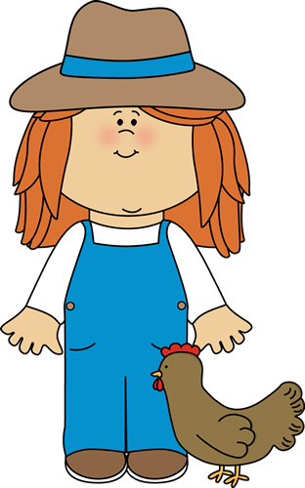
Farmer Isabelle comes to rescue the little Billy Goat from the river.

Slide 13
But who will rebuild the bridge?

Slide 14
Person A: you are in charge of the money – you need to buy enough bricks for the bridge and write down how much money you have spent.
Person B: you will design the bridge so that is strong enough to get the Billy Goats over the river. Draw and give instructions to the person building.
In your groups, give each person a letter: A, B, C and D.
Person C: you will be building the bridge – you need to follow the instructions you are given exactly.
Person D: When the bridge is finished you need to test that it is strong and safe enough to carry the Billy Goats over the river.
Notes:
Remember these are real people’s jobs: you must do exactly what your job is described as, and not try to do other people’s jobs.

Slide 15
Now you have built your bridge, have a chat about which skills each person needed most.

Slide 16
How did you make sure you didn’t run out of money?
What was the most challenging part?
Which parts did you most enjoy?
Which team members had to work together the most?
Do you think you were suited to your job, and why?
Are these jobs for girls and boys?

Slide 17
Quantity Surveyor
Building Operative
Civil Engineer
A
B
C
Health & Safety Adviser
D
Can you guess which of the visitors have which job?

Slide 18
Thank you from all the Billy Goats for rebuilding the bridge!
You can now swap jobs and try it again.

Slide 19
The East Sussex Primary Careers Hub
careerseastsussex.co.uk

