Slide 1
Careers and Aspiration
Why is careers related learning important in primary schools?
East Sussex Primary Careers Hub

Slide 3
Why?

Slide 4
Future Skills – The Fourth Industrial Revolution
These products did not exist 12 years ago. The world is changing fast, and we need to prepare children with the skills they need for the future.

Slide 5
Why Careers in Primary Schools?
Broaden horizons
Healthy sense of self
Reach potential

Slide 6
Why Careers in Primary Schools?
“Five times as many young people want to work in art, culture, entertainment and sport as there are jobs available.”
“Careers related learning in primary schools plays a key role in getting children excited about learning as well as tackling ingrained stereotypes and narrow aspirations they often have.”

Slide 7
What gets in the way of Aiming High?
Gender stereotypes
Concern over cost of study
Limited experience and aspiration
Low self-belief

Slide 8
How?

Slide 9
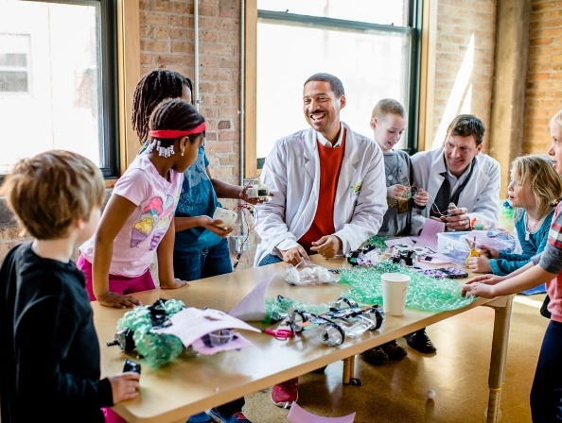
How do we teach Careers?
Workplace visits
Visitors invited in to schools
Developing employability skills

Slide 10
The Skills Builder Programme

Slide 11
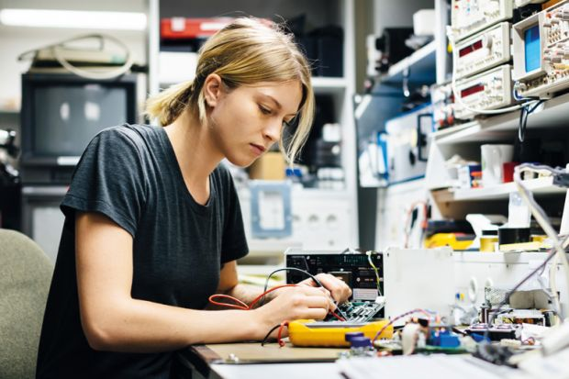
Challenge stereotypes
Careers Related Learning uses every opportunity to challenge stereotypes though discussion, and inviting visitors with careers children might not expect. This will reinforce the idea that careers must be open to all.

Slide 12
Thoughts for the future

Slide 13
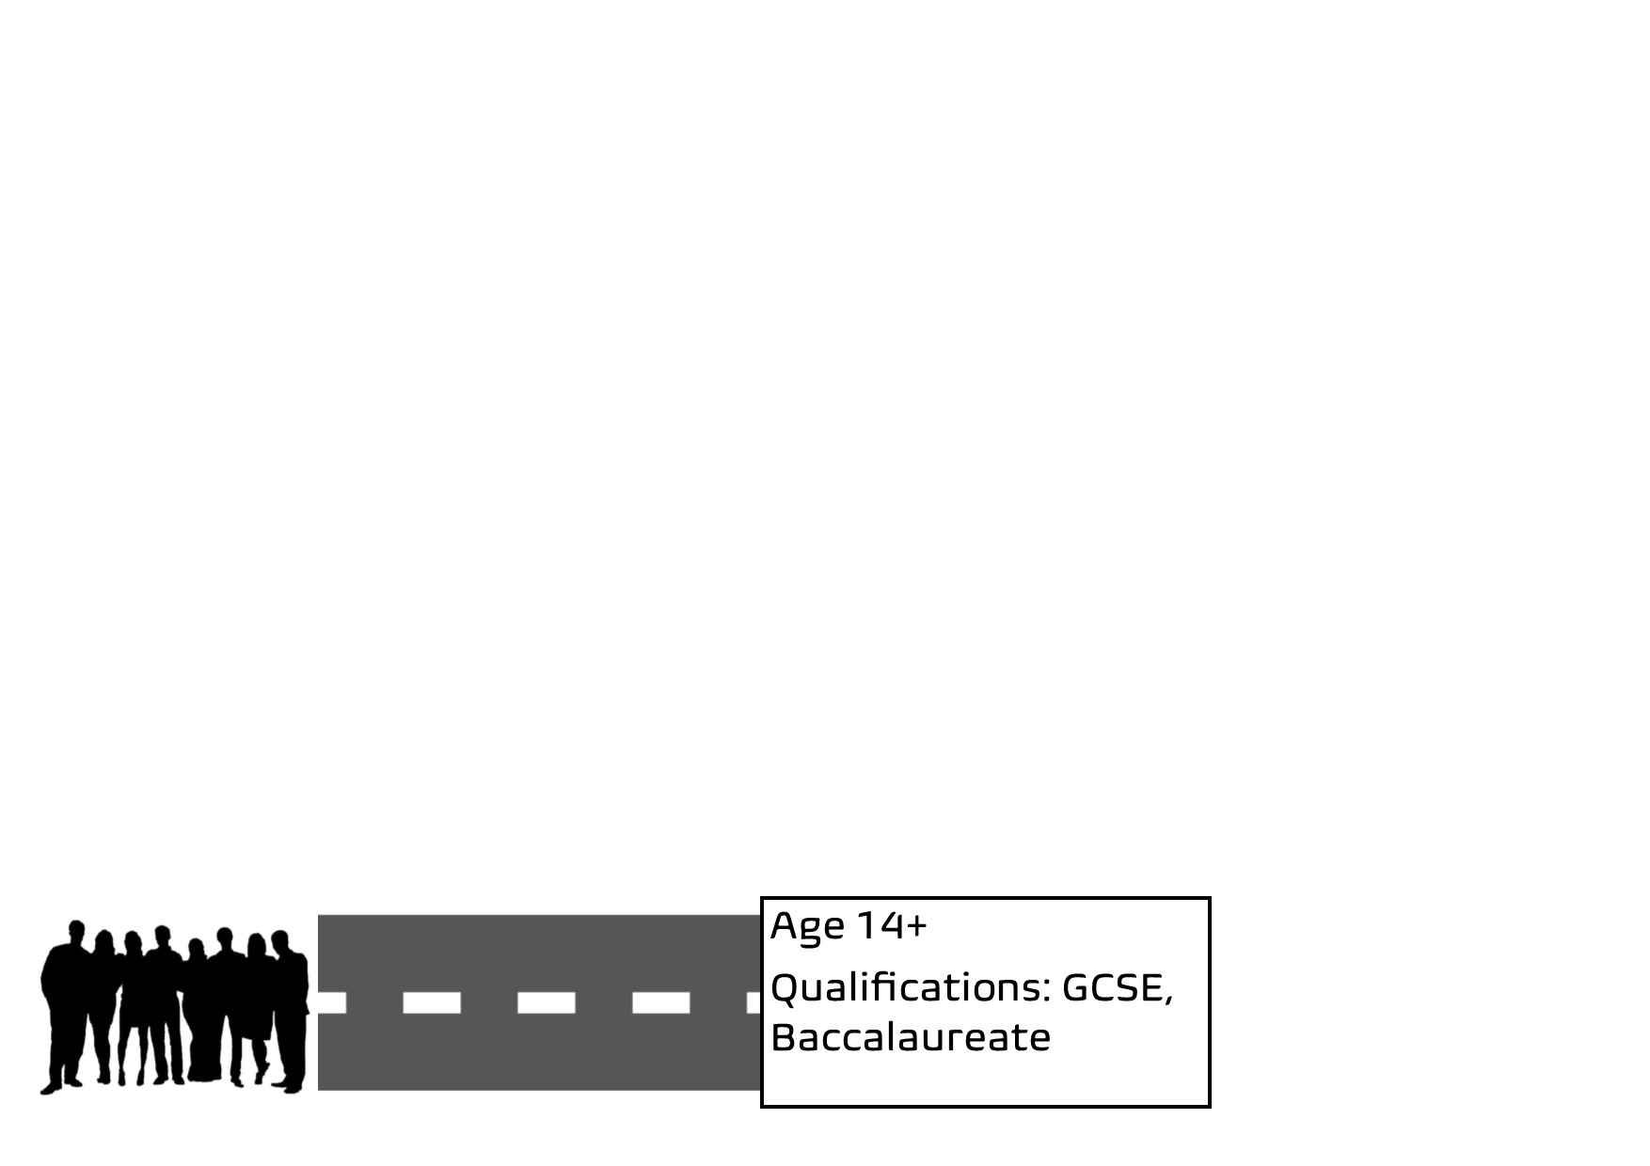
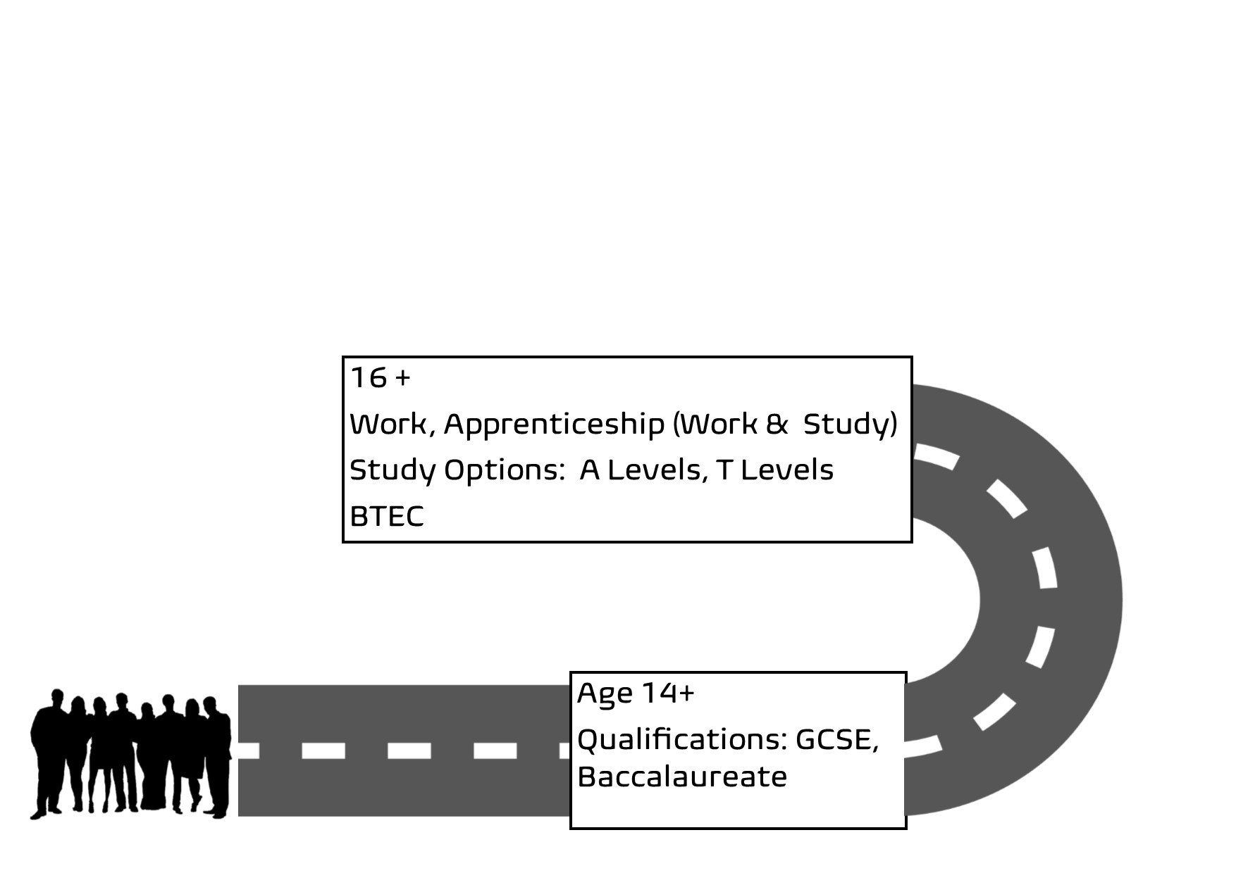
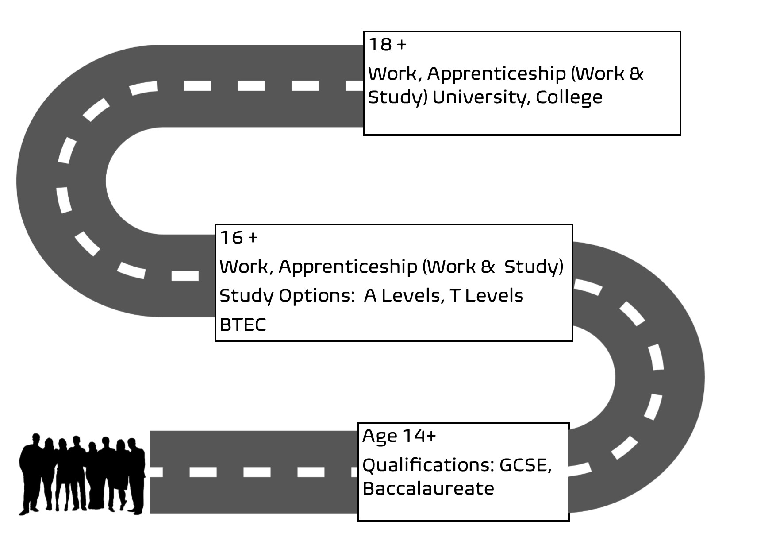
Career Paths

Slide 14
Be aware of different career paths
Encourage your child to aim high and not to be put off by cost of study. Explore bursaries, grants and loans as an option.
Explore apprenticeships; there are lots of opportunities for a successful career training without cost of study.
Get familiar with companies offering good potential to work your way up.

Slide 15
Be aware of sectors where there are lots of opportunities
Construction
Site managers
Trades: carpentry, plumbing, electrics
Civil engineers
Ground workers
Creative and Digital
Programmers & software developers
Marketing professionals and copywriters
Cyber security
Engineering
Mechanical engineers
Electrical engineers
Processing technicians
Vehicle engineers
Health and Social
Family support care workers
Occupational Therapists
Staff nurses
Social workers
Land Based
Horticulturalists
Gardeners
Veterinary Nurses
Visitor Economy
Restaurant & Hotel
Managers
Chefs

Slide 16
The East Sussex Primary Careers Hub
primarycareershub@eastsussex.gov.uk

