Slide 1
The Big Issue
Solving energy or waste issues

Slide 2
Learning objectives
Aim: I will gain insight into environmental issues
1. I will explore specific aspects of the Environment
2. I will learn about STEM related career pathways and jobs
3. I will develop the following skills:

Slide 3
What is STEM?
STEM stands for ‘Science, Technology, Engineering and Maths’
STEM is important because it relates to every part of our lives
Science is everywhere in the world around us.
Technology is continuously expanding into every aspect of our lives.
Engineering is the basic designs of roads and bridges, but also tackles the challenges of changing global weather and environmentally-friendly changes to our home.
Mathematics is in every occupation, every activity we do in our lives.

Slide 4
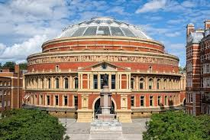
We need your help!!
The Big Issue - Waste
The UK produces more than 100 million tonnes of waste every year, one tonne is about the weight of a small car.
In less than two hours, the waste we produce would fill the Albert Hall in London

Slide 5
We need your help!!
Plastic Waste
We produce and use twenty times more plastic today than we did 50 years ago – plastic waste is a HUGE problem and is NOT going away!
In the UK over 5 million tonnes of plastic is consumed each year — and yet only one quarter (¼) of it is recycled.
The three quarters (¾) that isn’t recycled enters our environment, polluting our land and rivers. Around the world most of the plastic waste eventually ends up in the ocean, meaning that marine animals are especially at risk.

Slide 6
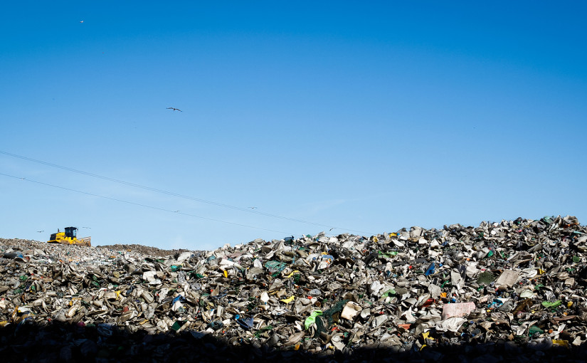
Question
Can you name 5 waste products in your home?
Think of the items you put in the rubbish bin.
What happens to those waste products?
Notes:
Deeper Learning Activity:
What could you do to reduce the need for these waste products?

Slide 7
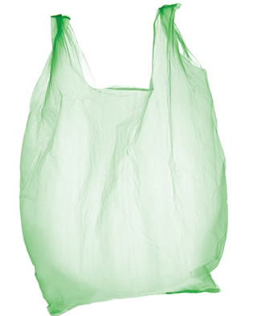
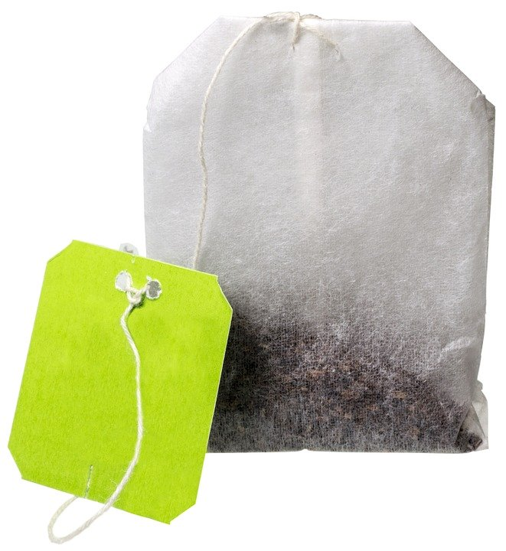
How long do I take to decompose?
Notes:
Using the ‘decompose’ activity sheet – children draw lines from each item to the time they think it takes to decompose

Slide 8
Answers:
Teabag | 1 month
Banana peel | 6 weeks
Apple core | 2 months
Woollen sock | 1 year
Plastic bag | 20 years
Magazines | 50 years
Plastic bottle | 450 years
Mobile phone | 1000 years
Notes:
Deeper Learning Activity:
Carry out research into decomposition times for different items

Slide 9
Plastic Recycling Facts
Recycling 1 plastic bottle saves enough energy to power a 60W bulb for 3 hours
Recycling a plastic bottle saves 90% of the energy taken to produce a new one
Fleece fabric can be made from recycled plastic
75% of plastic waste in the UK is sent to landfill
The UK currently recycles 24% of plastic while Germany recycles 44%

Slide 10
Notes:
Discuss:
What are Carbon Emissions?
When we talk about carbon emissions, we’re focusing specifically on carbon dioxide, or CO2.

Slide 11
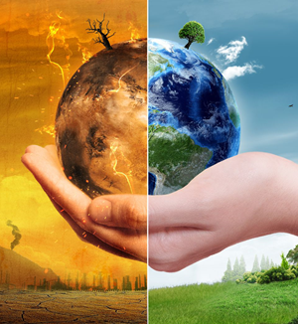
The Big Issue – Carbon Emissions
Why are we so concerned with carbon emissions?
They trap heat helping the planet to warm up which changes the climate
Notes:
Discuss:
Why are we so concerned with carbon emissions?
CO2 is one of the greenhouse gases that absorbs radiation and prevents heat from escaping our atmosphere. This excess heat creates disrupted weather patterns, higher global temperature averages and changes in the climate.

Slide 12
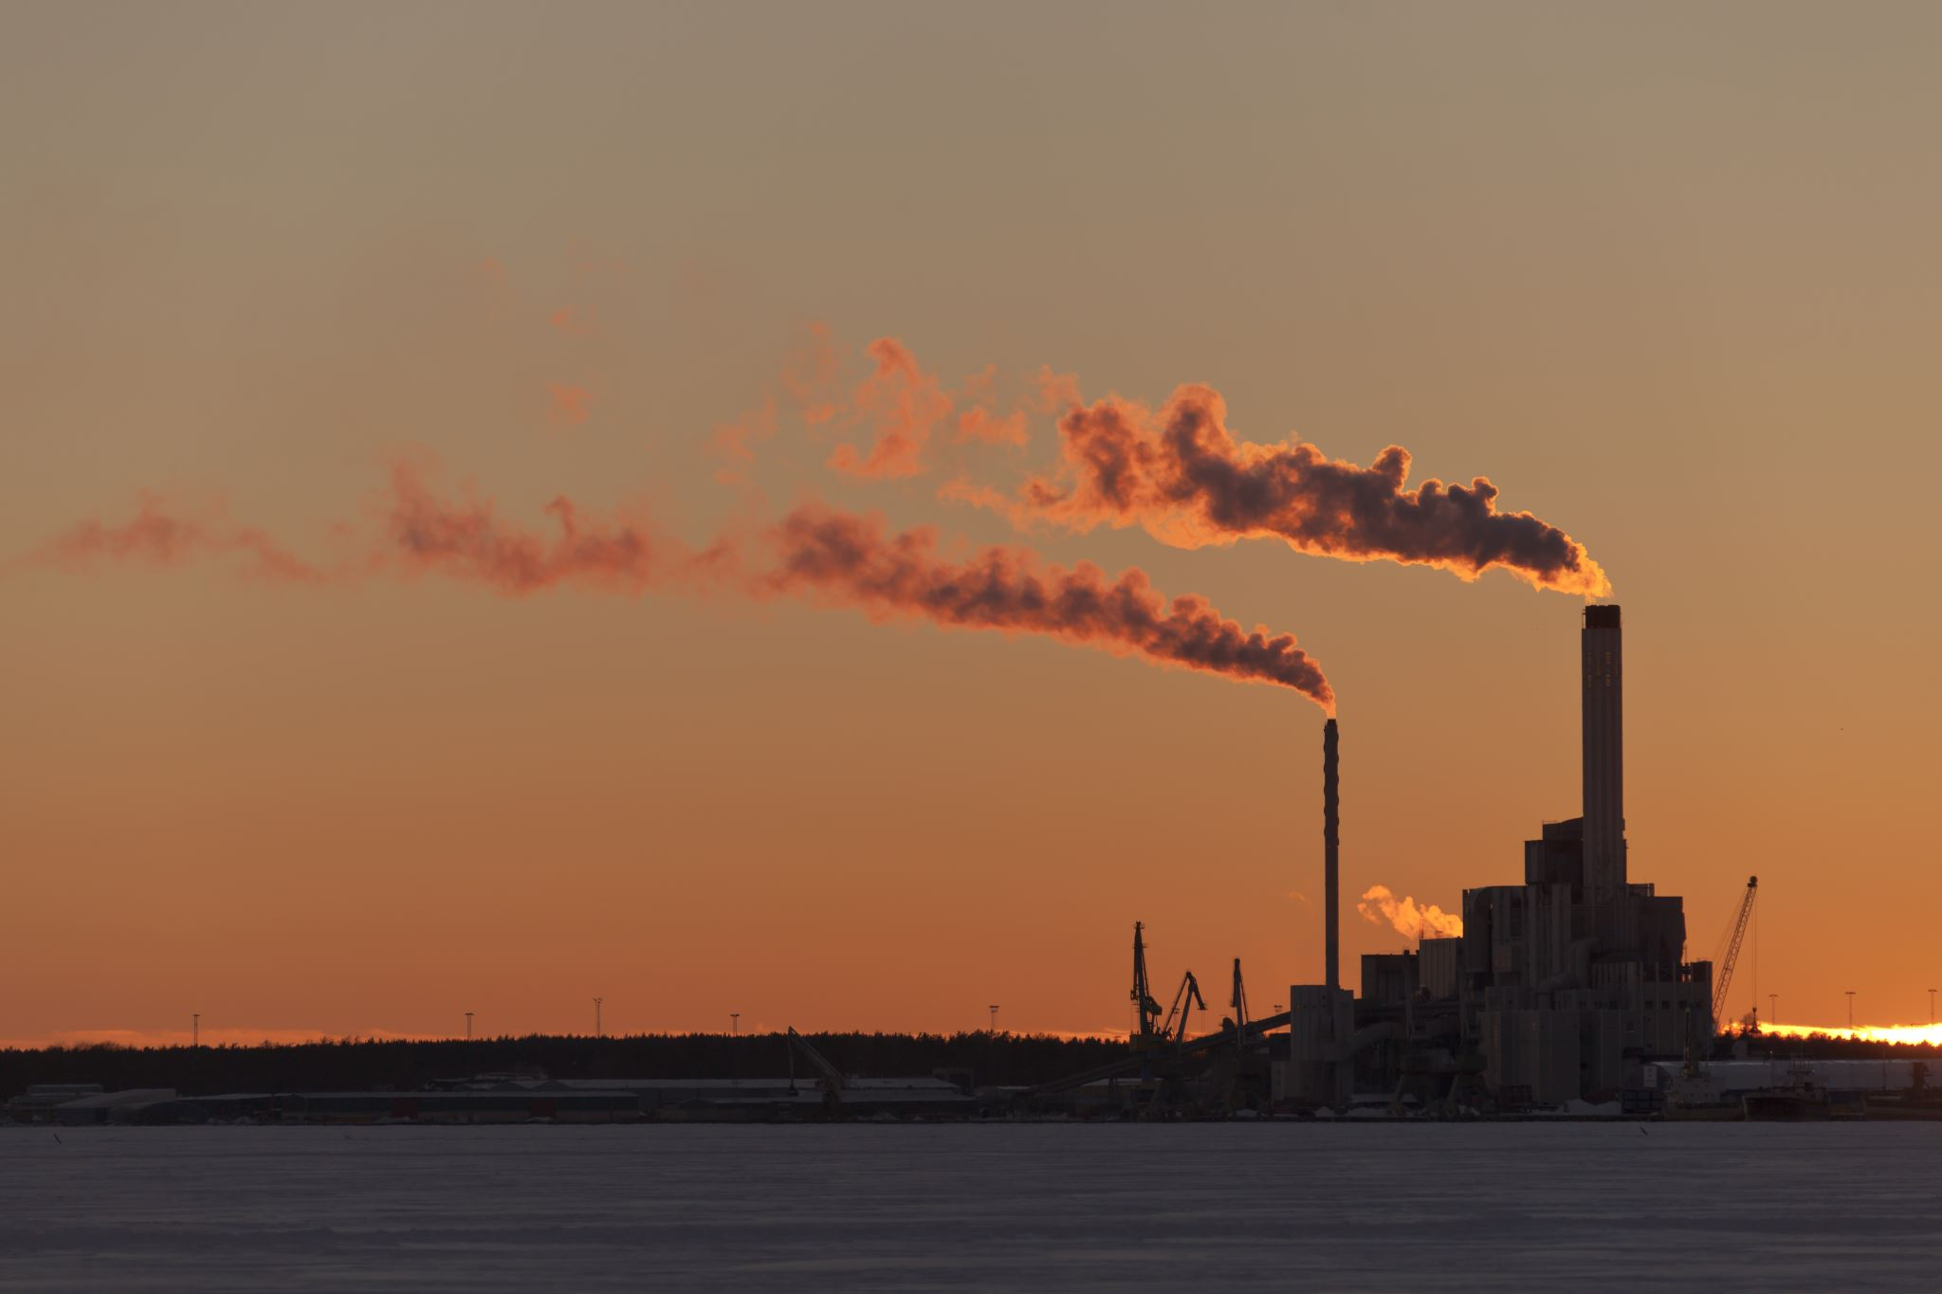
The Big Issue – Carbon Emissions
Why are Carbon
Emissions increasing?
We are burning fossil fuels
We are cutting down trees which
absorb carbon dioxide
Notes:
Discuss:
What are Carbon Emissions?
When we talk about carbon emissions, we’re focusing specifically on carbon dioxide, or CO2.

Slide 13
How do we generate electricity?
We burn coal, oil and natural gas to generate electricity.
Are there any problems with doing this?
Non – Renewable Energy
Notes:
Explore the different ways that electricity is made.
Discuss the definitions of renewable and non-renewable energy. Non-renewable energy resources (e.g. coal and oil) are still commonly used, but will eventually run out, and are releasing lots of pollution as they are burnt. Renewable energy resources (e.g. solar panels and wind turbines) are not going to run out, as they don’t ‘use up’ all of their source materials. Renewables also release far less pollution than non-renewables, so avoid contributing further to climate change.

Slide 14
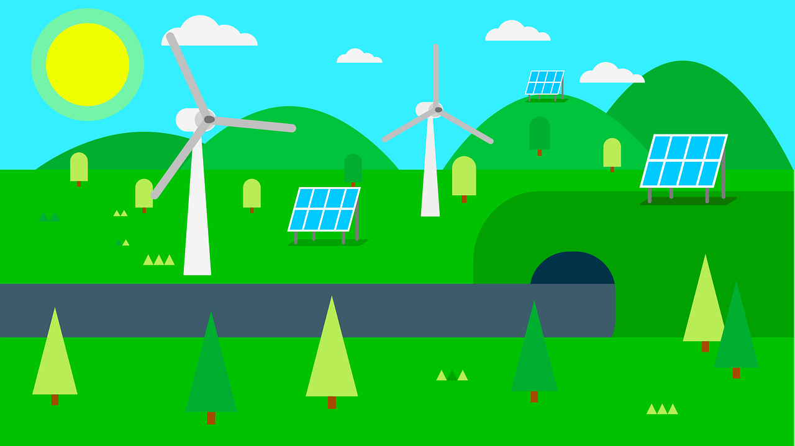
…Rather than burning coal, oil or natural gas, which will eventually run out, we do have some alternatives…
We can use renewable technologies, such as wind turbines and solar panels, to generate electricity. These will not run out and are better for our planet.
Renewable Energy
Notes:
Explore the different ways that electricity is made.
Discuss the definitions of renewable and non-renewable energy. Non-renewable energy resources (e.g. coal and oil) are still commonly used, but will eventually run out, and are releasing lots of pollution as they are burnt. Renewable energy resources (e.g. solar panels and wind turbines) are not going to run out, as they don’t ‘use up’ all of their source materials. Renewables also release far less pollution than non-renewables, so avoid contributing further to climate change.

Slide 15
What is Sustainability?
We use the term ‘sustainability’ to describe the way we use natural resources when this use is kept at a steady level that is not likely to damage the environment.
Examples of natural resources are:
Air
Water
Wood
Oil
wind energy
natural gas
Iron
Coal
Notes:
Discuss:
What are Carbon Emissions?
When we talk about carbon emissions, we’re focusing specifically on carbon dioxide, or CO2.

Slide 16
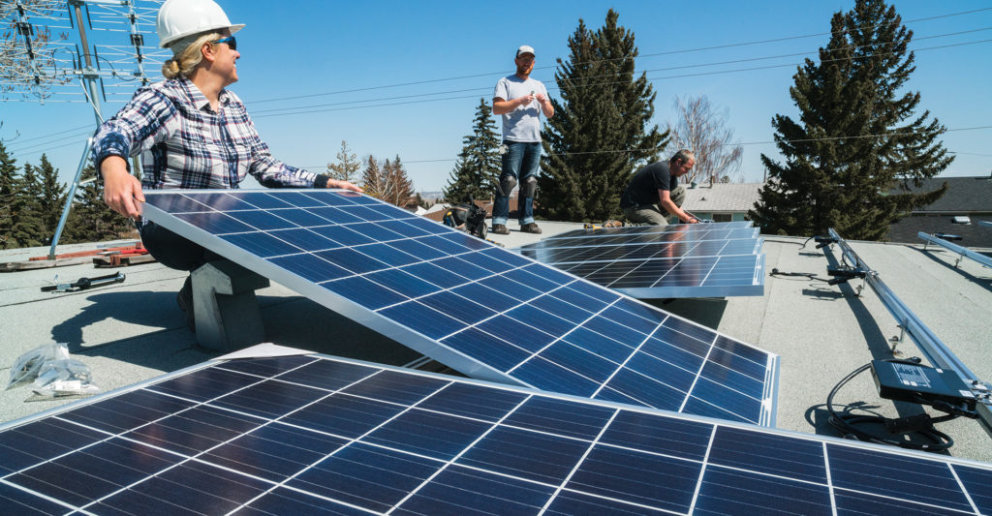
Jobs linked to renewable energy
Do you want to help save the planet?
Wind-turbine technicians and solar panel installers are amongst the fastest-growing jobs in the country
In the UK we are looking to support 27,000 new jobs in off-shore wind power alone!
Notes:
The renewable energy sector is a fast-growing and exciting industry that has lots of career paths to choose from.
Here an example of a well paid job you could do....

Slide 17
The Big Issue - Extinction
Humans are responsible for causing changes in the environment that hurt animals and plant species.
Human activity often changes or destroys the habitats that plants and animals need to survive.
A species is declared extinct after many years of not being spotted.
Scientists estimate that 150-200 species of plant, insect, bird and mammal become extinct every 24 hours.
Vocabulary definitions:
EXTINCT – a species that no longer has living members
HABITAT - the natural home or environment of an animal, plant, or other organism
ENDANGERED SPECIES – a species that is seriously at risk of extinction

Slide 18
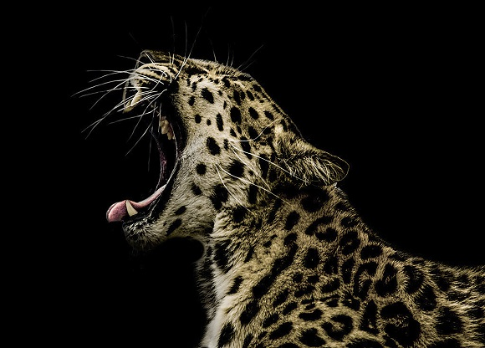
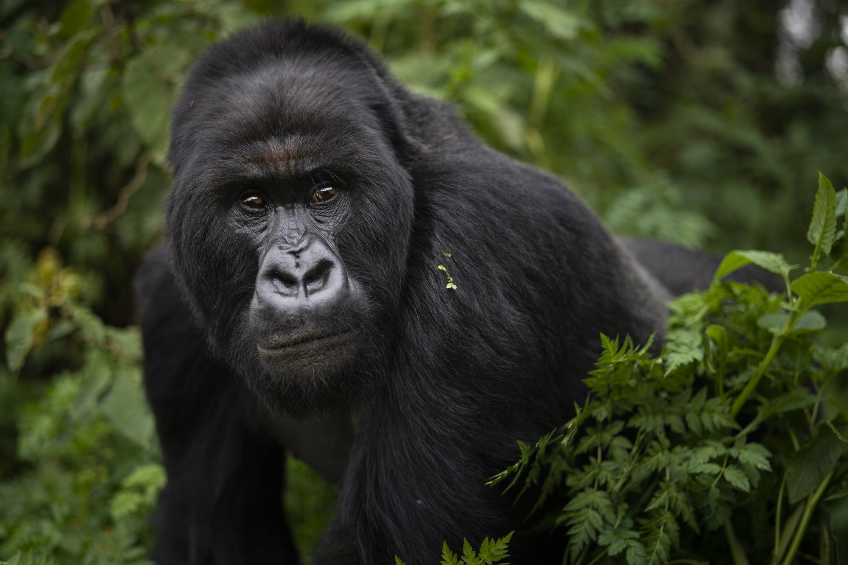
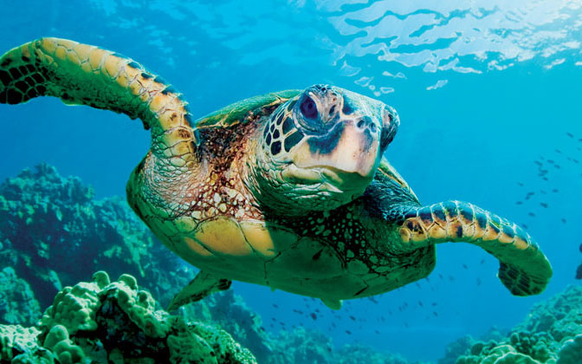
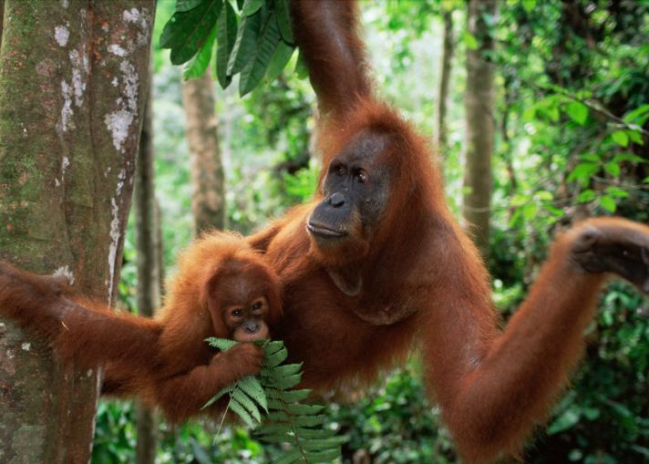
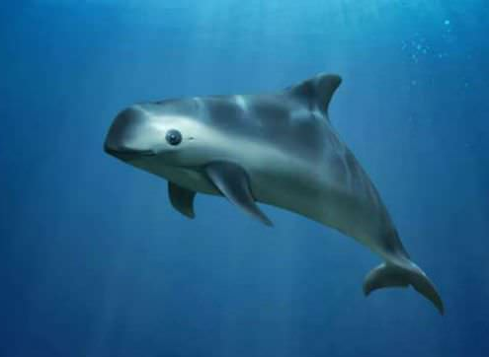
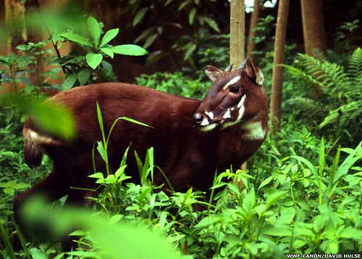
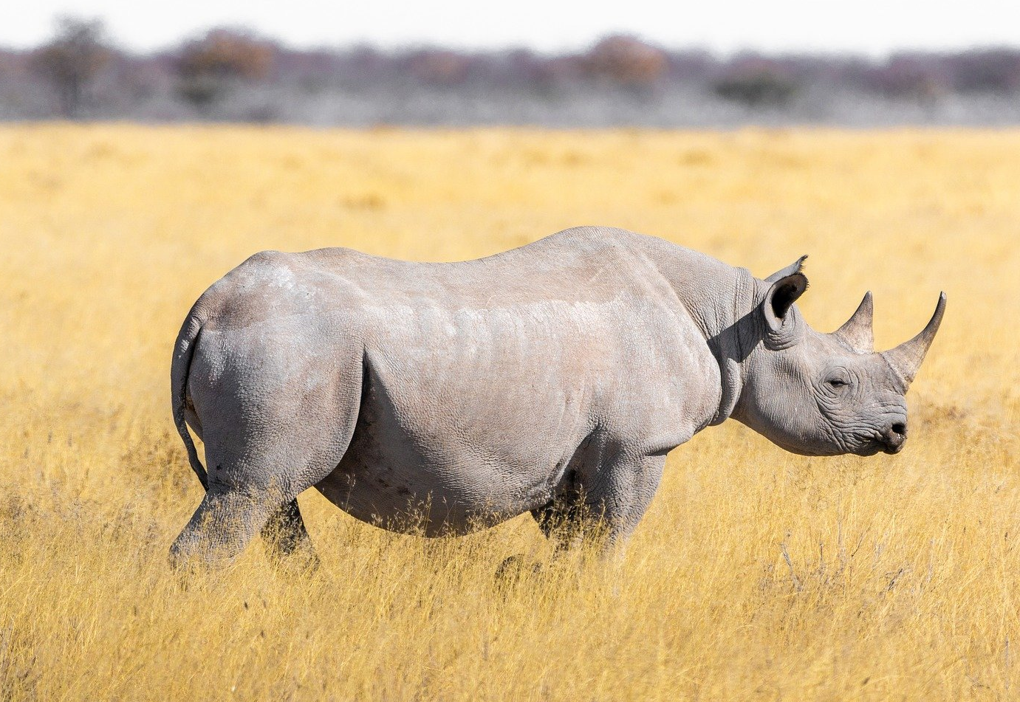
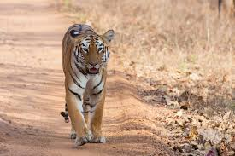
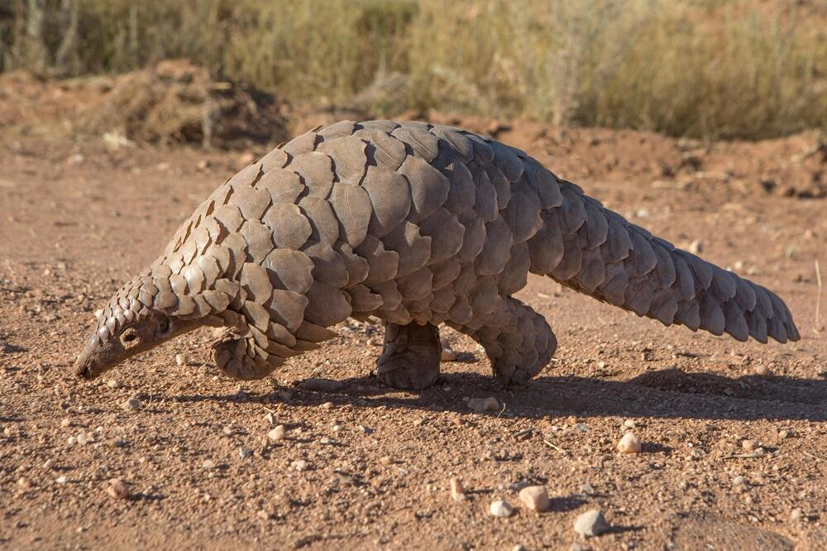
Top 10 endangered species
We need your help!

Slide 19
YOUR CHALLENGE: Make Posters to get the message out!
Sadly, many animal species are dangerously close to becoming extinct.
Raising awareness of this issue has never been more important!
Your challenge is to design a poster that will highlight the issues around endangered species and extinction.
Include facts or figures relating to these issues or written messages on ways to stop this destruction.
Here are some poster ideas:
The rainforest being chopped down and taking away habitats for many animals.
Houses being built on farmland
Roads or rail tracks being built through forests
Notes:
The renewable energy sector is a fast-growing and exciting industry that has lots of career paths to choose from.
Here’s 2 examples of well paid jobs you could do....

Slide 20
Jobs linked to the environment
Do you want to help save the planet?
Become an Environmental Lawyer!
Advise people on issues related to air and water quality, hazardous waste, sustainability, and more.
This profession will continue to grow as climate change impacts the earth!
Notes:
The renewable energy sector is a fast-growing and exciting industry that has lots of career paths to choose from.
Here’s 2 examples of well paid jobs you could do....

Slide 21
Notes:
The renewable energy sector is a fast-growing and exciting industry that has lots of career paths to choose from.
Here’s 2 examples of well paid jobs you could do....

Slide 22
Meet an ambassador from the world of work
Hello my name is…
Ask me questions to try and guess what my job is
Notes:
This is a perfect opportunity to integrate employer engagement into this session –
Invite volunteers from the world of work to visit your school, talk to your children about their careers and support your activities. Having the opportunity at primary school to meet a wide range of people doing different jobs is really important and hearing them talk about their careers can be so inspiring! There are some great online portals that you can use to link with employers and invite volunteers into your school. Here are a couple of them:
Primary Future: https://primaryfutures.org/schools/how-to-sign-up/
STEM Learning: https://www.stem.org.uk/stem-ambassadors
Careers and Enterprise Company: https://www.careersandenterprise.co.uk/schools-colleges/join-our-network
A fun way of introducing your ambassador is to run a ‘what’s my line’ activity where the children try to guess the job of the ambassador - you will find the guide for this here however you can simplify this to work in a classroom with just one volunteer https://www.inspiringthefuture.org/wp-content/uploads/2014/12/Easy-Steps-to-running-a-Primary-Futures-Whats-My-Line-event.pdf

Slide 23
Have you hear of the four ‘R’s?
Rethink – Explore ways to improve how we make and use plastic and finding alternatives that are less harmful to the environment.
Recycle - reprocess the product or some of its parts to make something else.
Reuse - use the whole product or some of its parts to make something else.
Reduce - cut down the amount of plastic we use or reducing the energy and/or materials used to make the product..

Slide 24
Notes:
Waste Fashion Show: Using the litter you have brought in from home, it is now time to get imaginative and create your masterpieces!!
(working in small groups the children create outfits and accessories from the ‘waste’ they have brough in (i.e. plastic bags, bottles, containers, cartons)
Emphasis on three of the 4 Rs – Rethink, Reuse and Recycle

Slide 25
8 skills
Notes:
Skills for success – Focus on these for this project – leave on screen while the fashion show commences
Teamwork – make sure everyone is taking part
Presenting – some team members model the outfits while others ‘present’ their creation by narrating their designs to the audience
Problem solving – Your idea may be harder to come together than you thought before – how can you change something to make it work?
Creativity – think outside of the box – just because it’s a milk carton doesn’t mean it needs to contain milk!!
Listening – listen to everyone’s ideas before just going ahead with what you think is best – link to teamwork
Leadership – Everyone’s ideas are valid but you must come to an agreement on how to move your product forward from the planning to the making stage. Who will lead on what element of your creation?
Staying positive – It may not work the first time, but find a solution!
Aiming high – make something you are proud of!

Slide 26
Learning Objective 1: To gain an insight into environmental issues
Quiz to check understanding:
1. What takes longer to decompose?
a) Plastic bottle
b) Plastic bag
c) Magazine
2. Explain what the words EXTINCT, HABITAT and ENDANGERED SPECIES mean
Notes:
Ask children these questions – pick a raised hand to suggest an answer
1. Answer: A plastic bottle – 450 years
HIGHLIGHT THE IMPORTANCE OF RECYCLING
2. Answer:
Extinct: A species that no longer has living members
Habitat: the natural home or environment of an animal, plant, or other organism
Endangered species: – a species that is seriously at risk of extinction

Slide 27
Questions continued
3. What happens to plastic waste that is NOT recycled?
4. Why does deforestation increase our planet’s carbon dioxide levels?
5. Give examples of renewable and non-renewable energy
Notes:
3. Answer:
Plastic enters our environment, polluting our land and rivers. Around the world the majority of plastic waste eventually ends up in the ocean, meaning that marine animals are especially at risk.
4. Answer:
Trees absorb carbon dioxide
5. Answer:
Renewable energy examples: .solar panels and wind turbines and hydro energy
Non-renewable energy examples: coal, gas and oil

Slide 28
Do you want to help save the planet?
Conservation and wildlife - work with animals, work in the countryside, nature reserves Climate and energy - research and engineers - work with solar energy, wind power turbines, water power Ecology - study living things and their environment - in parks, laboratories and zoos - research and scientists Food and farming - growing crops and food production, farming animals - farmers, farming assistants, Horticulture - growing plants, crops for food, flowers - working in garden centres, parks, landscape gardeners,
Notes:
Skills for success – Focus on these for this project – leave on screen while the fashion show commences
Teamwork – make sure everyone is taking part
Presenting – some team members model the outfits while others ‘present’ their creation by narrating their designs to the audience
Problem solving – Your idea may be harder to come together than you thought before – how can you change something to make it work?
Creativity – think outside of the box – just because it’s a milk carton doesn’t mean it needs to contain milk!!
Listening – listen to everyone’s ideas before just going ahead with what you think is best – link to teamwork
Leadership – Everyone’s ideas are valid but you must come to an agreement on how to move your product forward from the planning to the making stage. Who will lead on what element of your creation?
Staying positive – It may not work the first time, but find a solution!
Aiming high – make something you are proud of!

Slide 29
Learning Objective 2: To learn about a range of STEM careers
Can you think of a job that YOU would like to do in the future that could help save the environment?
Draw a picture of yourself doing this job
Write a sentence below your picture to explain why you would like to do this job
Notes:
Learning objective 2: To learn about a range of STEM careers.
This activity helps the children reflect on what they have learnt about STEM careers and apply this learning to possible future careers they could do
Play the children a video that will inspire them around different STEM careers
Here are some examples:
On the Job: Zoologist https://www.youtube.com/watch?v=CNMbCOCZRV0
https://www.youtube.com/watch?v=arL0ejafxxE
That’s a Real Job – Robotics Engineer: https://www.youtube.com/watch?v=2gIRajloxhI
Space Farmer: https://www.youtube.com/watch?v=1zrfiuhBqoE
Set the children a challenge to think of a job they may like to do that could help protect the environment

Slide 30
Objective 3: To develop the following key skills
Notes:
For each skill in turn – ask for a volunteer to tell the room how they have achieved each skill

